Slide 1
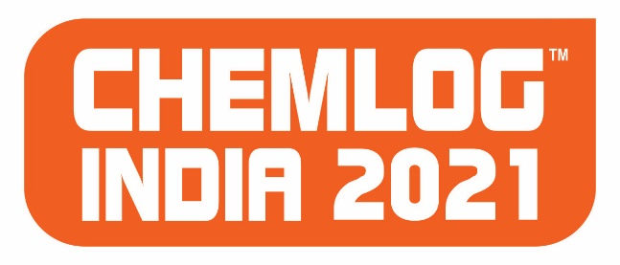
Re-defining and driving growth trajectory of chemicals supply chain - Leveraging assets and networks
Dr.K.Ganesh
Global Lead, Manufacturing & Supply Chain Center of Competence
Senior Knowledge Expert and Associate Partner
+91-9867604177, k_ganesh@mckinse.com
December 2021

Slide 2
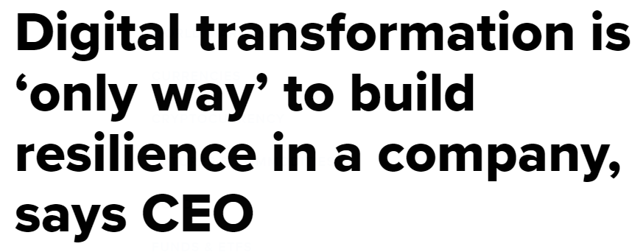
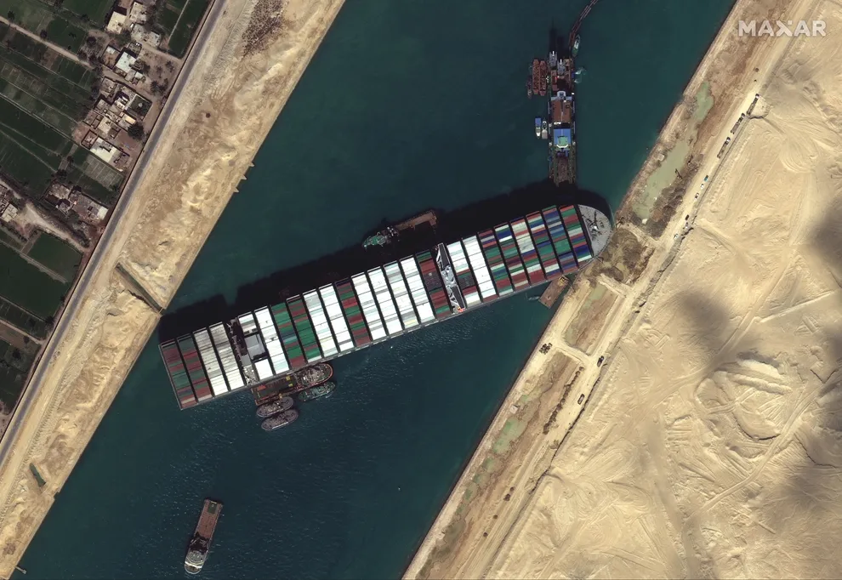
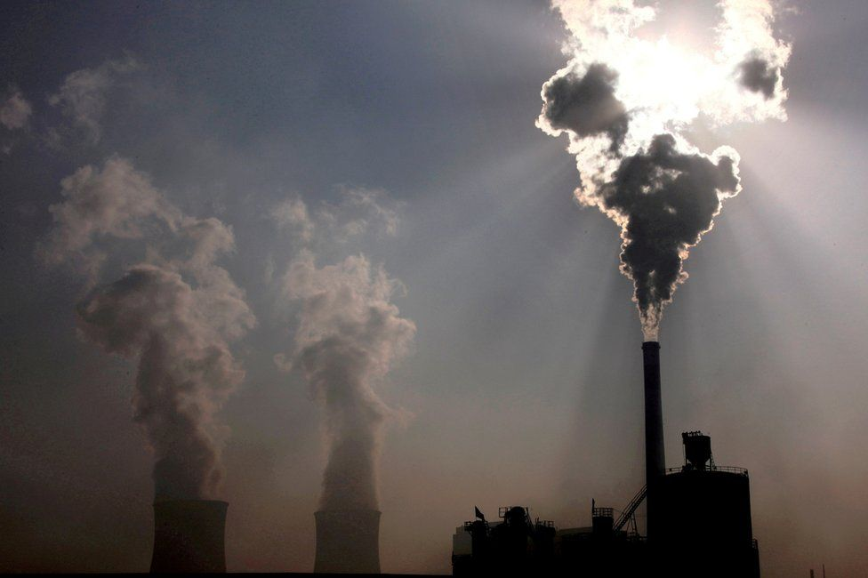
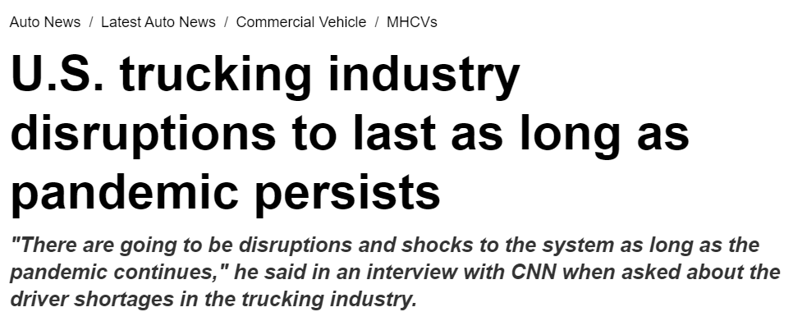
Did we learn anything from the global disruptions and climate change impact over the last year?
McKinsey & Company
2

Slide 3
Focus on risk, compliance and resilience
Digital disruption and automation
Sustainability and green
Evolving themes in chemicals
supply chain
Physical flow / logistics optimization
E2E planning
% of respondents
Focus of discussion
Lean manufacturing
McKinsey & Company
3

Slide 4
Chemlog 2021 focus is in similar lines
Is India the next destination?
Disruption is the name of the game
Current Affairs
Maturity of Indian logistics sector
Compliance is the name of the game

Slide 5
Agenda
Is India the next destination?
Disruption is the name of the game
Current affairs

Slide 6
Indian exports to the world have seen a sharp increase, rising by ~11% in last 20 years
India’s total export volume in 2020 was 313.3 USD Billion
India’s exports have risen sharply from nearly 44 USD Billion in 2001 to it’s all time high of 336 USD Billion in 2013
The top 10 export goods and services have a huge chunk of share of nearly 60% in the total export value
2014 Dip: India’s export in 2014-2016 period decreased due to global slowdown and decrease in demand from China
Total Export Value of goods and services in USD billion
Export Value
350
+11% p.a.
300
250
200
150
100
50
0
2000
02
04
06
08
10
12
14
16
18
2020
Year
Source: UN Comtrade, Ministry of Commerce and Industry

Slide 7
Commodity exports account for ~USD 313 billion export value in 2020, with mineral fuel and precious gems holding ~25% of the share
(Top 15 leading export of India by revenues; FY20)
India is the world’s largest exporter of Diamonds
Mineral fuels and oils
$42.7 B
Gems & Jewelry
India receives the highest commodity export revenues from USA, raking in almost $53bn (FY20) from the country
$36 B
Machine & mechanical appliances
$20.8 B
Total commodity exports
$313.3B
Organic chemicals
Cotton
$5.7 B
$17.4 B
Fish ad other seafood
$6.2 B
Auto vehicles
$16.7 B
Cereals
$6.6 B
India is also the largest exporter of rice globally
Plastics
$16.3 B
Pharma products
$6.9 B
Articles of Iron and steel
$7 B
Electric machinery equipment
$7.5 B
$15.2 B
Knitted apparel
$8 B
$9.2 B
Non-knitted apparel
Iron & steel
Source: Ministry of Commerce and Industry

Slide 8
Top 10 principal exports in terms of commodity groups account for as much as 78% of total merchandise exports
USD Billions, FY 2019
Mineral Fuels and Oils
Pearls, precious/ semi-precious stones
Nuclear reactors, boilers and machinery
Organic Chemicals
Vehicles and parts (non-railway)
Pharmaceutical parts
Electrical machinery and equipment
Iron and Steel
Apparel and clothing (non-knitted, non-crocheted)
Apparel and clothing (knitted, crocheted)
Source: Trademap

Slide 9
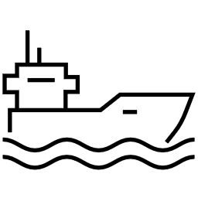
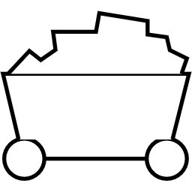
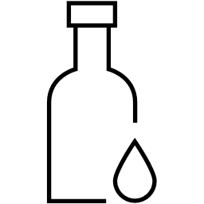
10 countries account for more than 50% of India's export volumes, with USA and UAE capturing majority shares of 16.8% and 9.8% respectively
USD Billions, FY 2020
Products
United States of America
1.Pearls, precious/ semi-precious stones, 2.Pharmaceutical products, 3.Nuclear reactors, boilers and machinery, 4.Mineral fuels and oils, 5.Vehicles and parts (non-railway)
United Arab Emirates
1.Pearls, precious/ semi-precious stones, 2.Mineral Fuels and Oils, 3.Electrical Machinery and Equipment, 4.Ships, boats and floating structures, 5.Apparel and Cloths, knitted or crocheted
China
1.Organic chemicals, 2.Mineral fuels and oils, 3.Ores, slag and ash, 4.Fish and Crustaceans, 5.Cotton
Hong Kong, China
1.Pearls, precious/ semi-precious stones, 2.Electrical Machinery and Equipment, 3.Essential Oils and Resinoids, 4.Mineral fuels and oils, 5.Raw hides, skin and Leather
Singapore
1.Mineral fuels and oils, 2.Ships, boats and floating structures, 3.Nuclear reactors, boilers and machinery, 4.Pearls, precious/ semi-precious stones, 5.Organic Chemicals
United Kingdom
1.Nuclear reactors, boilers and machinery, 2. Apparel and Cloths, non-knitted or non-crocheted, 3. Apparel and Cloths, knitted or crocheted, 4. Pearls, precious/ semi-precious stones, 5.Pharmaceutical products
Netherlands
1.Mineral Fuels and Oils, 2.Organic chemicals, 3.Electrical Machinery and Equipment, 4.Apparel and Cloths, knitted or crocheted, 5.Edible fruit and nuts
Germany
1.Nuclear reactors, boilers and machinery, 2.Organic chemicals, 3.Electrical Machinery and Equipment, 4.Apparel and Cloths, knitted or crocheted, 5.Apparel and Cloths, not knitted or crocheted
Bangladesh
1.Cotton, 2.Vehicles and parts (non-railway), 3.Mineral fuels and oils, 4.Nuclear reactors, boilers and machinery, 5.Iron and steel
Nepal
1.Mineral fuels and oils, 2.Iron and steel, 3.Vehicles and parts (non-railway), 4.Nuclear reactors, boilers and machinery, 5.Cereals
Source: Trademap

Slide 10
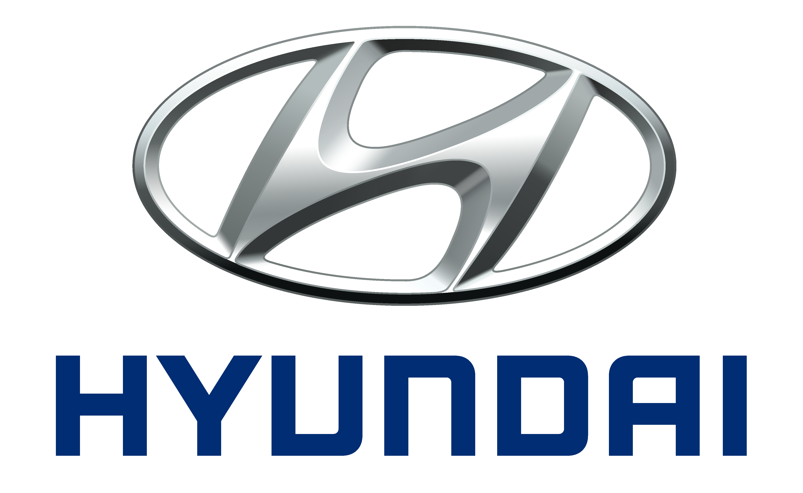
Key industries holding best cost country (BCC) sourcing opportunities in India
Pharmaceutical
Chemical and Petrochemicals
Automobile, Textile, Chemical, Engineering
Textile, Chemical
Automobile
Engineering
Pharma, Chemical, FMCG
Engineering, FMCG
FMCG
Pharma, Automobile, Textile, Chemical, Engineering, FMCG
Textiles and Apparels
FMCG
Pharma
Textiles, Automobile, Chemical
Source: IBEF, Invest India, McK Analysis

Slide 11
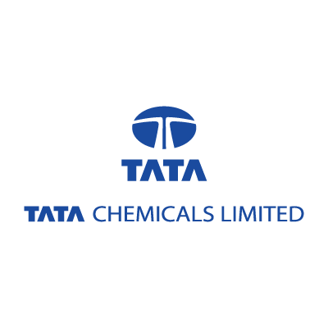
Chemical and Petrochemical Industry
India is fourth largest Agrochemicals manufacturer and sixth largest manufacturer of chemicals in the world
India is a big global dye supplier, holding approximately 16% of the world production of dyestuff and dye intermediates
100% FDI is allowed under the automatic route in the chemicals sector
Tax breaks and special incentives through PCPIRs (Petroleum, Chemical and Petrochemical Investment Region) or SEZs will further support the industry
Due to global monopoly of OPEC countries, India is importing fuel and petroleum in large amount. However, the processing and distribution of petrochemical products cater to a huge chunk of the Indian Market
Export
Import
In USD Billions
Source: IBEF, Invest India, Ministry of Commerce and Industry

Slide 12
Agenda
Is India the next destination?
Disruption is the name of the game
Current affairs

Slide 13
We see three areas of potential significant impact for Digital and dvanced Analytics (AA) in Chemicals supply chain
Enabling technology
1
Probabilistic demand forecasting using predictive analytics (e.g., statistical regression and machine learning) and leveraging big data
Increased forecast accuracy and granularity
Machine learning: tree-based models, neural networks, etc.
Advanced computing
Predictive analytics in demand planning
2
E2E network optimization including closed-loop planning & margin-optimized production incorporating raw material supply, production planning, distribution, inventory, sales and demand
Digital S&OP with integrated profit optimization
Real-time supply chain visibility / transparency
Advanced optimization engines
Advanced modelling (e.g., multi-method modelling)
Cloud-based technologies
Digital ways of working (DWoW)
Analytics based E2E network optimization
3
Automated warehouse robots, robotic / automated cargo handling, autonomous guided vehicles (AGVs) for transport
Increased speed, flexibility and safety while reducing cost
Robotics including sensory systems
Artificial intelligence (AI) & cognitive systems
Robotics in material handling and transport

Slide 14
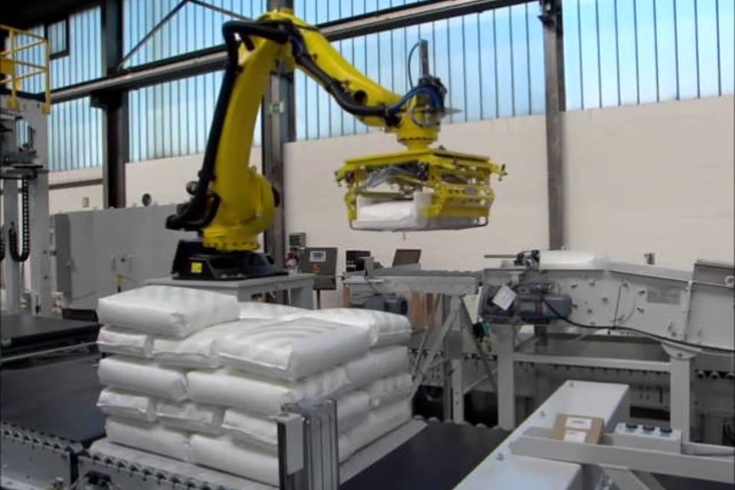
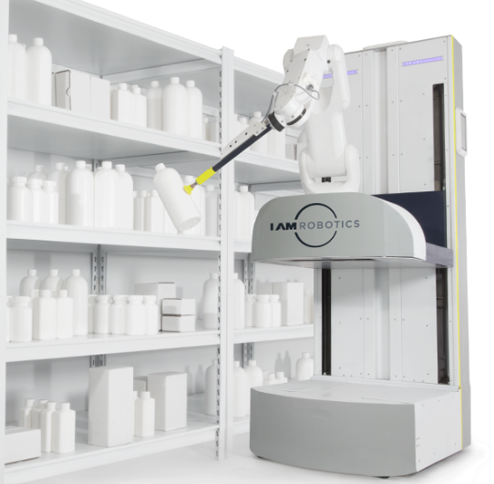
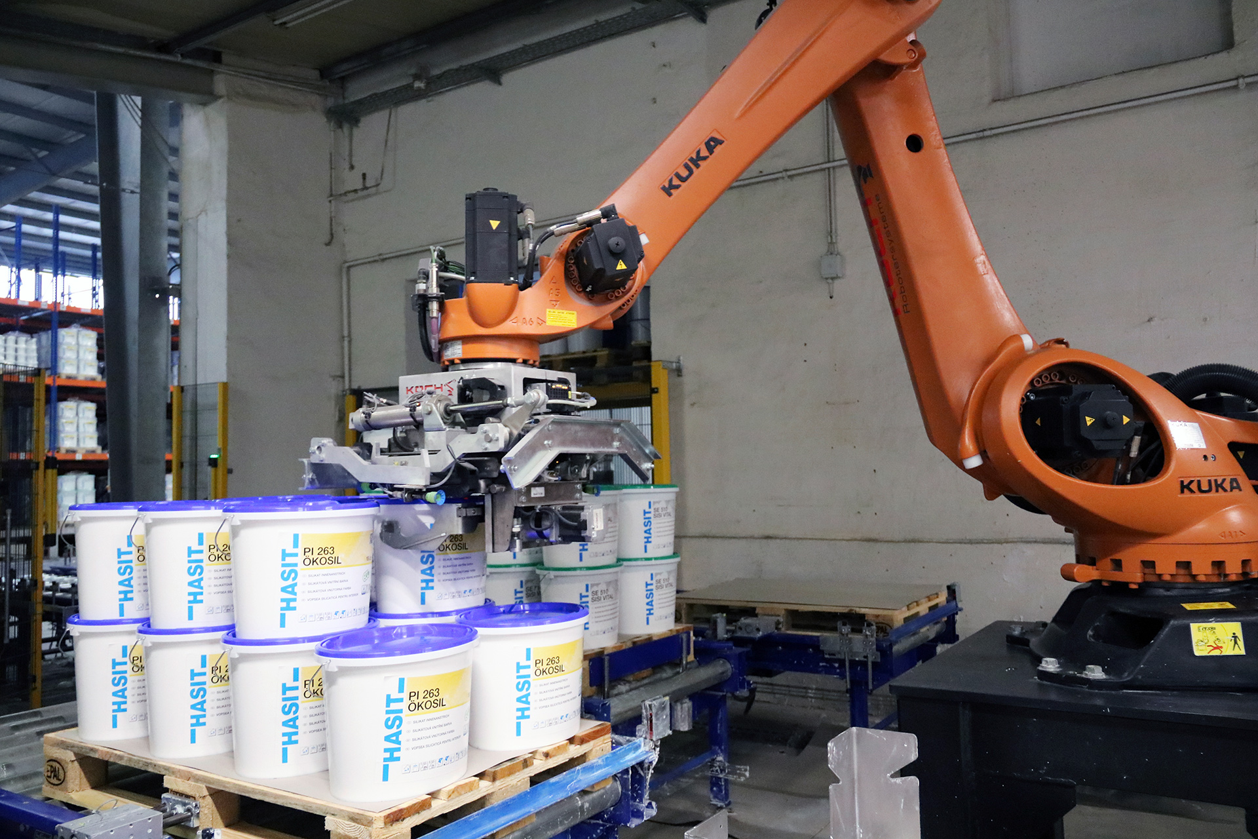
Robotics use case examples in Chem SC and logistics (1/2)
ROBOTICS IN SUPPLY CHAIN AND LOGISTICS
Warehouse picking
Palletizing and depalletizing
IAM Robotics' Swift picks up specialty chemicals to fill order
Vision technology enables the robot to see and locate objects in 3D and real-time
Automated barcode scanning ensures the right products are picked and packed
Palletizing & depalletizing robots can autonomously handle incoming raw materials and end-of-line packing and loading
Robots can palletize / depalletize cases, boxes, bags, buckets, etc.
For example…
MMCI robots palletize bags of fertilizer
Kuka robots palletize buckets of chemicals
Robotic systems can also unload and load trucks
Autonomous loading / unloading significantly, if not completely, reduces need for human handlers for loading and unloading
MMCI robot palletizes bags of fertilizer
Swift picks up specialty chemicals
Kuka robot palletizes buckets of chemicals
SOURCE: IAM Robotics, Kuka, MMCI

Slide 15
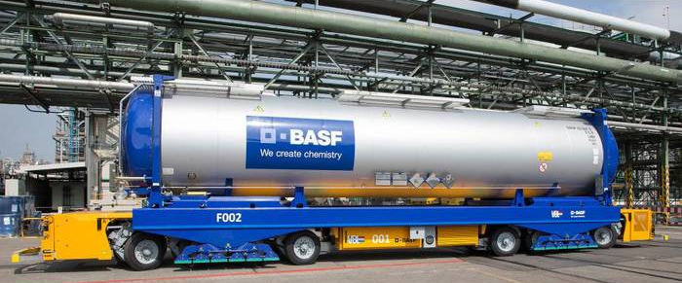
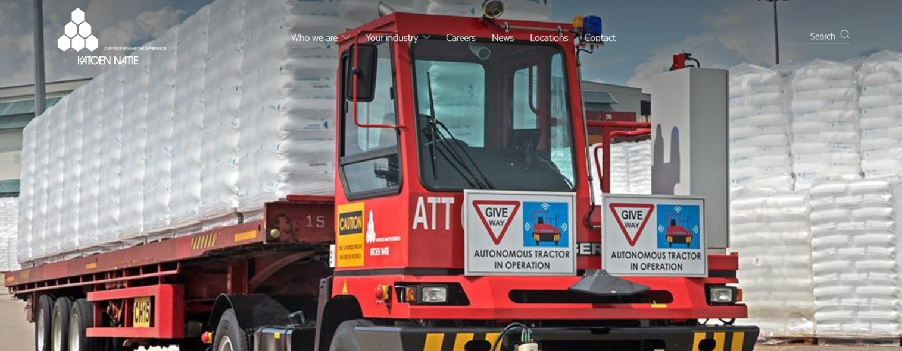
Robotics use case examples in Chem SC and logistics (2/2)
ROBOTICS IN SUPPLY CHAIN AND LOGISTICS
Autonomous cargo movement
BASF partnered with the VDL Groep to develop an autonomous guided vehicle
The AGV is steered via transponders embedded in the road surface
It formerly took around 22 hours for a railway tank car to be delivered from BASF’s train station to one of the loading stations at the site; with the AGV, this time is cut to just one hour
BASF & VDL’s autonomous guided vehicle transports chemicals
Katoen Natie started operating its first driverless truck at ExxonMobil’s world-scale integrated manufacturing site in Singapore in 2018, transporting products between the company’s packaging and intermediate storage facilities
The pilot truck will operate on a 24/7 basis moving some 250,000 tons of product annually
After a six-month test run, the project will be gradually expanded to 12 trucks, moving some 3 million tons of product annually
Katoen Natie’s autonomous guided vehicle transports chemicals
SOURCE: VDL Group, BASF, Katoen Natie, ExxonMobil

Slide 16
A digital S&OP process enables a new operating model with cross-functional digital interfaces
E2E ANALYTICS BASED NETWORK OPTIMIZATION
PI
Prices
Inventory
Data lake
Capacity
Product mix / profit optimization
Process optimization
Process model suggests process parameters
Profit model suggests production mix (grades) to produce
Volume mix
Digital Performance mgmt.
Digital Operations
Digital S&OP process
Digital product mgmt.
Digital Sales
Production teams debrief shift performance on digital whiteboards
Control room and field operators use real-time optimized parameters to run the process
Digital S&OP meeting btwn production, product and planner to test scenarios & validate production mix
Product manager makes volume allocation simulations to maximize asset utilization
Commercial representative makes price / volume simulation during negotiation

Slide 17
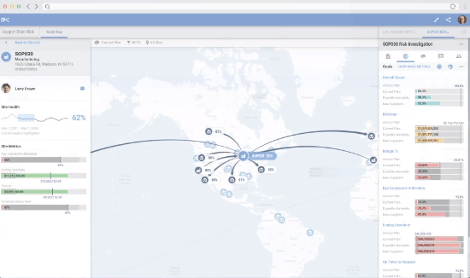
BASF targets E2E Supply Chain transparency with Kinaxis
ADDITIONAL EXTERNAL EXAMPLES
BASF recently piloted Kinaxis RapidResponse®, a leading cloud-based supply chain management solution based on concurrent planning
RapidResponse uses a single cloud-based planning platform that lets users plan concurrently (via advanced analytics and machine learning) for every part of the supply chain – from sales and operations planning (S&OP) to demand, inventory, supply, capacity
“
Creating a transparent and connected business process is key to our supply chain operations. Kinaxis provides us with the E2E planning platform, reducing planning latency, improving alignment of dependent processes, and fostering transparency between all functional elements of our business
- Mr. Jan Brüning, Smart Supply Chain Cluster Lead, BASF
”
SOURCE: http://info.kinaxis.com/request-for-demo?campaign=70139000000ee8J&ls=ii

Slide 18
Agenda
Is India the next destination?
Disruption is the name of the game
Current affairs

Slide 19
Rates have surged
Rate development by trade lane, USD / FEU
16,000
SCFI Shanghai-Europe
SCFI Shanghai-WC America
SCFI Shanghai-EC America
12,000
8,000
~7.6x
4,000
0
January 2019
November
2021
1. Additional surcharges putting it more than quoted prices
Source: SCFI data sourced from SIN Clarksons
McKinsey & Company
19

Slide 20
But it’s not driven by global demand – only North America sees a peak
Cumulative average growth rate vs. 2 years before, %
20
15
North America
10
5
Global
Europe
0
Other regions
-5
-10
-15
Jan
Feb
Mar
Apr
May
Jun
Jul
Aug
Sep
Oct
Nov
Dec
Jan
Feb
Mar
Apr
May
Jun
Jul
Aug
Sep
2020
2021
Source: Container Trade Statistics

Slide 21
Container liners and other owners are expected to continue investing in new boxes to solve the equipment shortage
Illustrative
Liners are already investing to grow their fleet employing a mix of owning and leasing strategy:
Maersk: increased 40-foot HC fleet by 9.7%, in 2020 and expects to increase that by a further 2% in 2021
Hapag-Lloyd: executed an order of 210,000 container since April 2021
CMA CGM: increased its container fleet by 8.7% in the second half of 2020.
Leasing company
Leasing company
Transport operator
Container fleet by owner category
Million TEU
30
56%
20
54%
10
52%
0
50%
2017
18
19
20
21
22
23
2024
Source: Drewry's Container Equipment Forecaster 4Q20; JOC; McKinsey

Slide 22
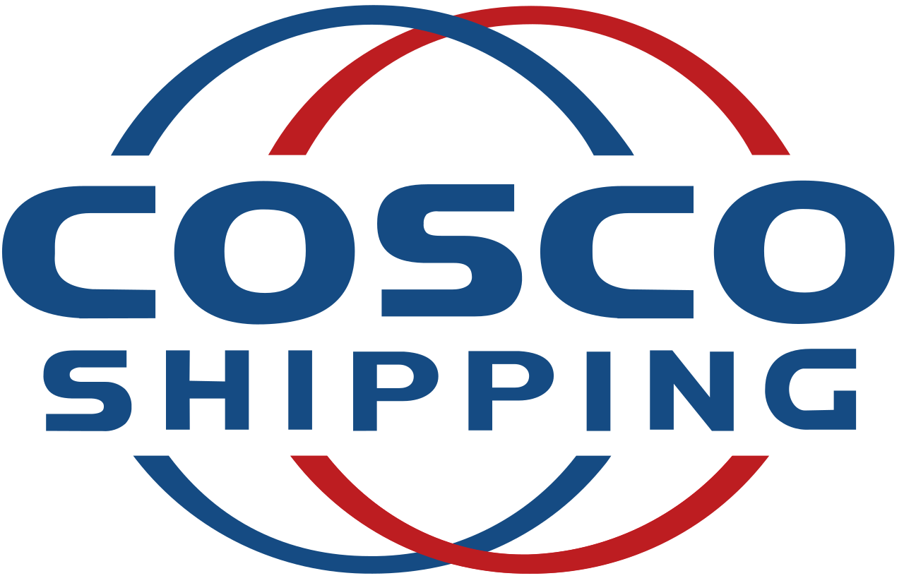
Liners slowly adding orders for new vessels with some aggressively – Evergreen’s current orderbook is >50% of its capacity
Top container liners current orderbook, 000 TEUs
xx%
Orderbook as a share of existing capacity
> 18,000 TEU
10,000 - 13,999 TEU
14,000 - 17,999 TEU
< 10,000 TEU
22%
50%
18%
14%
23%
16%
53%
19%
16%
1%
917
688
541
425
415
252
220
163
98
46
1. As of August 8th
Source: Alphaliner; McKinsey
Sources: Transmodal (30.04.2021), Alphaliner (23.06.2021), Clarksons (06.05.2021), Desk research

Slide 23
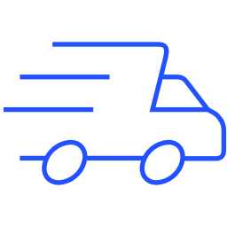
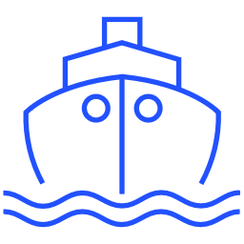
Current disruption is expected to normalize over the next 5-6 months in the ‘Optimistic scenario’
Deep dive on our Optimistic Scenario
Constrained
Constraint begins easing
Stable operation
Marginal capacity relief expected before EOY
Relief in most subsystems
Stabilization at ‘new normal’
Q4 2021
Q1 2022
Q2 2022
Q3 2022
Q4 2022
Value chain
Ports
Volume significantly slowing down from peak
Terminals improve loading/unloading productivity and process vessels faster as congested yards loosen
Drayage
Drayage crunch slowly easing up as demand slows down
Chassis and other equipment availability improves with increased turnover and empty dropping appointments slots increase
Port and Hinterland logistics transport
Rail intermodal
Rail catching up demand and improving dwell time
Cargo owners leveraging weekend-in gates to and extended hours to discharge loaded cargo quickly to hinterland
Over-the road trucking
Driver capacity improving slowly
Trucking companies increase cooperation with customers to ease shortage (e.g. labor assistance at DCs)
Equipment availability
Intervention improving existing equipment turnover
New domestic container and chassis to start entering service
Warehousing
Capacity remaining tight until peak season is over
Intermodal companies and shippers align their working hours to keep sufficiently staffed warehouses open 24/7, and move loaded containers quickly using newly unlocked capacity
Ocean carriers
Holiday season cargo is either en route or already delivered – no increase in flows
Liners deploy extra loaders to reposition empties back to Asia and opening space at empty storage of terminals
Ocean transport
Equipment availability
Intervention improving existing equipment turnover
New container boxes orders start entering service
Labor
Labor availability
Labor shortage remains
Trucking/drayage and other sectors improving labor availability using labor coming back from e-ecommerce sector
Source: External expert interviews

Slide 24
VIDEO

Slide 25
Thank You End

